Slide 2
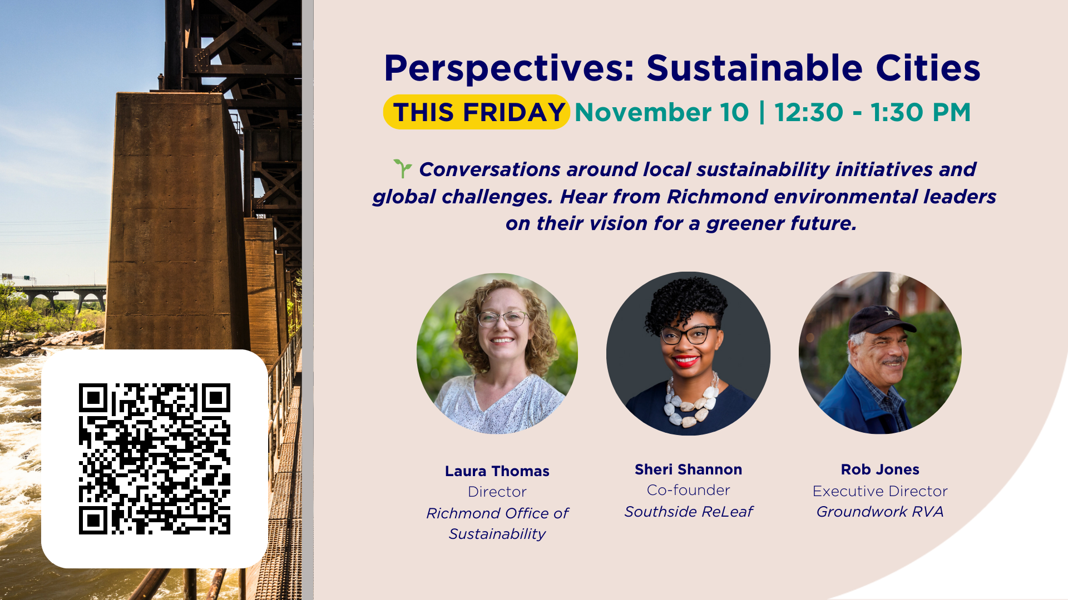

Slide 16
Sustainability.richmond.edu

